Slide 1
The Logic of Compound Statements
Session 1-3
Course : MATH6182 – Discrete Mathematics
Effective Period : September 2021

Slide 2
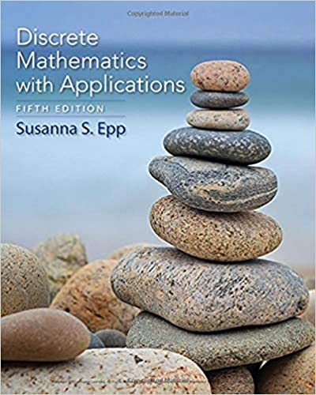
These slides have been adapted from :
Susanna S.Epp, “ Discrete Mathematics with Applications”, 5th edition,2020, Cengage, Boston, USA, ISBN 9781337694193
Chapter 2
Acknowledgement

Slide 3

Learning Objectives
On successful completion of this Course, students will be able to:
LO1:
Explain the logic of compound statements, digital logic circuits, and quantified statements

Slide 4
Sub Topics
1
Logical Form and Logical Equivalence
2
Conditional Statements
3
Valid and Invalid Arguments
  Digital Logic Circuits
4

Slide 5
Logical Form And Logical Equivalence
Logic Is A Science Of The Necessary Laws Of Thought, Without Which No EmploymentOf The Understanding And The Reason Takes Place. —Immanuel Kant, 1785

Slide 6
Statements
Definition
A statement (or proposition) is a sentence that is true or false but not both.
Propositions | Not Propositions
3 + 2 = 32 | Bring me coffee!
5 – 2 = 3 | x + y > 0
Every cow has 4 legs. | 3 + 2
There is other life in the universe. | Do you like Cake?

Slide 7

Negation
Definition
If p is a statement variable, the negation of p is "not p" or "It is not the case that p" and is denoted ~p.
Truth Table for ~p

Slide 8
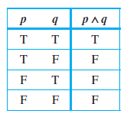
Conjunction
Definition
If p and q are statement variables, the conjunction of p and q is "p and q" denoted p q.
It is true when, and only when, both p and q are true. If either p or q is false, or if both are false, p q is false.

Slide 9
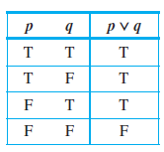
Disjunction
Definition
If p and q are statement variables, the disjunction of p and q is "p or q," denoted p v q.
It is true when either p is true, or q is true, or both p and q are true; it is false only when both p and q are false.

Slide 10
A Statement Form (Proposition)
Definition
A statement form (or propositional form) is an expression made up of statement variables (such as p, q, and r) and logical connectives (such as ~, , and v) that becomes a statement when actual statements are substituted for the component statement variables.
The truth table for a given statement form displays the truth values that correspond to all possible combinations of truth values for its component statement variables.

Slide 11
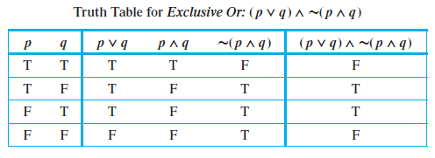
Truth Table for Exclusive Or

Slide 12
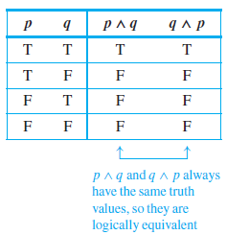
Logical Equivalence
Definition
Two statement forms are called logically equivalent If and only if, they have identical truth values for each possible substitution of statements for their statement variables. The logical equivalence of statement forms P and Q is denoted by writing P ≡ Q.

Slide 13
Example: De Morgan’s Laws
Statements of the form are logically equivalent.
Symbolically,
and

Slide 14
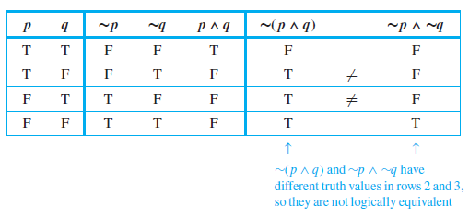
Showing Nonequivalence
The statement forms ∼(p ∧ q) and ∼p ∧ ∼q are not logically equivalent

Slide 15
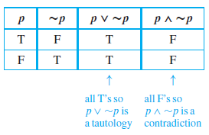
Tautology and Contradiction
Definition
A tautology is a statement
form that is always true.
A statement whose form is
a tautology is a tautological
statement.
A contradiction is a statement form that is always false. A statement whose form is a contradiction is a contradictory statement.

Slide 16
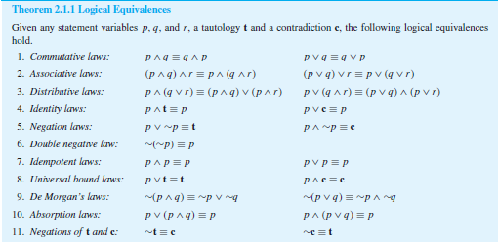
Summary of Logical Equivalences

Slide 17

Simplifying Statement Forms
Example : Use Theorem 2.1.1 to verify the logical equivalence
∼(∼p ∧ q) ∧ (p ∨ q) ≡ p.
Solution:

Slide 18
Conditional Statements
…Hypothetical Reasoning Implies The Subordination Of The Real To The Realm Of The Possible … —Jean Piaget, 1972

Slide 19
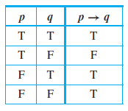
Conditional Statements
(Implication)
Definition
p → q
It is false when p is true and q is
the conditional of q by p is
"If p then q" or "p implies q"
and is denoted
false; otherwise it is true.
If p and q are statement variables,
We call p the hypothesis (or antecedent) of the conditional and q the conclusion (or consequent).

Slide 20
Example : Conditional Statements
A conditional statement that is true by virtue of the fact that its hypothesis is false is often called vacuously true or true by default.
Example :
the statement
“If you show up for work Monday morning, then you will get the job”
is vacuously true if you do not show up for work Monday morning.
In general, when the “if” part of an if-then statement is false, the statement as a whole is said to be true, regardless of whether the conclusion is true or false.

Slide 21

The Negation of a Conditional Statement
Example : Write negations for each of the following statements:
a. If my car is in the repair shop, then I cannot get to class.
b. If Sara lives in Athens, then she lives in Greece.
Solution :
a. My car is in the repair shop and I can get to class.
b. Sara lives in Athens and she does not live in Greece.
(Sara might live in Athens,Georgia; Athens, Ohio; or Athens, Wisconsin.)

Slide 22
The Contrapositive, Converse and
Inverse of a Conditional Statement
Definition
Suppose a conditional statement of the form
The contrapositive is “If ~q then ~p” or (~q → ~p)
The converse is “If q then p“ or (q → p)
The inverse is "If ~p then ~q" or (~p → ~q)
“If p then q” is given.

Slide 23

The Contrapositive, Converse and
Inverse of a Conditional Statement
Example :
Write each of the following statements in its equivalent contrapositive , Convers and Inverse form:
a. If Howard can swim across
the lake, then Howard can
swim to the island.
b. If today is Easter, then
tomorrow is Monday.
This Photo by Unknown Author is licensed under CC BY

Slide 24
The Contrapositive, Converse and
Inverse of a Conditional Statement
Solution
Contrapositive : If Howard cannot swim to the island, then Howard cannot swim across the lake.
Converse: If Howard can swim to the island, then Howard can swim across the lake.
Inverse: If Howard cannot swim across the lake, then Howard cannot swim to the island.
b. Contrapositive : If tomorrow is not Monday, then today is not Easter.
Converse: If tomorrow is Monday, then today is Easter.
Inverse: If today is not Easter, then tomorrow is not Monday

Slide 25

Biconditional (Biimplication)
Definition
Given statement variables p and q,
the biconditional of p and q is
It is true if both p and q have the
same truth values and is false if p
and q have opposite truth values.
"p if and only if q" and is denoted
p ↔ q.
The words if and only if are sometimes
abbreviated iff.

Slide 26
Order of Operations for
Logical Operators
Evaluate negations first.
When both are present, parentheses may be needed.
When both are present, parentheses may be needed
1.
2.
3.

Slide 27
Logically Equivalent : Biconditional
Definitions of if and only if, saying “p if, and only if, q” should mean the same as saying both “p if q” and “p only if q.”

Slide 28
Example : Biconditional
Rewrite the following statement as a conjunction of two if-then statements:
This computer program is correct if, and only if, it produces correct answers for all possible sets of input data.
Solution
If this program is correct, then it produces the correct answers for all possible sets of input data;
If this program produces the correct answers for all possible sets of input data, then it is correct.

Slide 29
Necessary and Sufficient
Conditions
Definition
If r and s are statements:
r is a sufficient condition for s means “if r then s.”
r is a necessary condition for s means “if not r then not s.”
r is a necessary condition for s also means
“if s then r.”
r is a necessary and sufficient condition for s means “r if, and only if, s.”

Slide 30

Converting a Sufficient
Condition to If-Then Form
Rewrite the following statement in the form “ If A then B ”:
Pia’s birth on U.S. soil is a sufficient condition
for her to be a U.S. citizen.
Solution
If Pia was born on U.S. soil,
then she is a U.S. citizen.

Slide 31
Converting a Necessary
Condition to If-Then Form
Use the contrapositive to rewrite the following statement in two ways:
Solution :
Version 1: If George has not attained the age of 35, then he cannot be president of the United States.
Version 2: If George can be president of the United States, then he hasattained the age of 35.
George’s attaining age 35 is a necessary condition for his being president of the United States.

Slide 32
Valid And Invalid Arguments

Slide 33
Valid and Invalid Arguments
Definition
An argument is a sequence of statements (or proposition). All statements (or proposition) in an argument except for the final one, are called premises (or assumptions or hypotheses). The final statement or statement form is called the conclusion.
The symbol ∴ , which is read "therefore," is normally placed just before the conclusion.
To say that an argument is valid means that if the resulting premises are all true, then the conclusion is also true.

Slide 34
Valid and Invalid Arguments
Testing an Argument Form for Validity
1. Identify the premises and conclusion of the argument form.
2. Construct a truth table showing the truth values of all the premises and the conclusion.
3. A row of the truth table in which all the premises are true is called a critical row. If there is a critical row in which the conclusion is false, then it is possible for an argument of the given form to have true premises and a false conclusion, and so the argument form is invalid. If the conclusion in every critical row is true, then the argument form is valid.

Slide 35
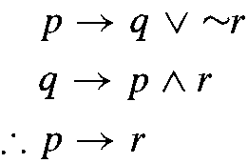
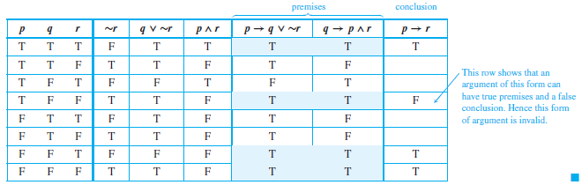
An Invalid Argument Form
Show that the following argument form is invalid.

Slide 36
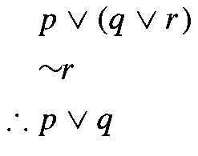
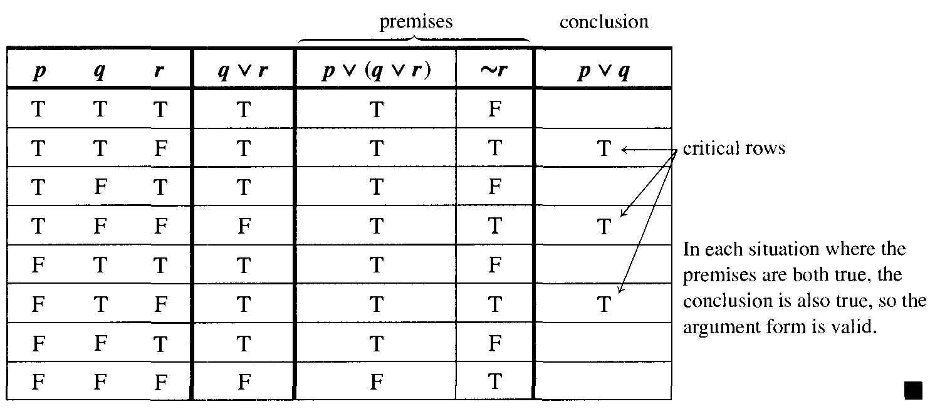
A Valid Argument Form
Show that the following argument form is valid

Slide 37
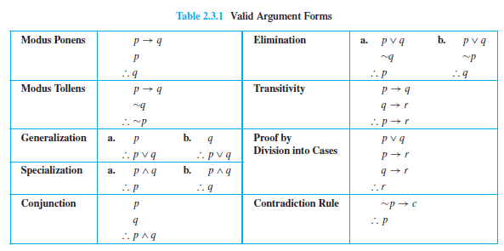
Rules of Inference

Slide 38
Application: A More Complex Deduction
You are about to leave for school in the morning and discover that you don’t have your glasses. This statements are true:
a. If I was reading the newspaper in the kitchen, then my glasses are on the kitchen table.
b. If my glasses are on the kitchen table, then I saw them at breakfast.
c. I did not see my glasses at breakfast.
d. I was reading the newspaper in the living room or I was reading the newspaper in the kitchen.
e. If I was reading the newspaper in the living room then my glasses are on the coffee table.
Where are the glasses?

Slide 39
Application: A More Complex Deduction
Solution :
Let
RK = I was reading the newspaper in the kitchen.
GK = My glasses are on the kitchen table.
SB = I saw my glasses at breakfast.
RL = I was reading the newspaper in the living room.
GC = My glasses are on the coffee table.

Slide 40
The conclusion
1. RK → GK by (a)
GK → SB by (d)
∴ RK → SB by transitivity
2. RK → SB by the conclusion of (1)
∼SB by (c)
∴ ∼RK by modus tollens
3. RL ∨ RK by (d)
∼RK by the conclusion of (2)
∴ RL by elimination
4. RL → GC by (e)
RL by the conclusion of (3)
∴ GC by modus ponens
∴ Thus the glasses are on the coffee table.

Slide 41
Fallacies
A fallacy is an error in reasoning that results in an invalid argument.
Three common fallacies are using ambiguous premises, and treating them as if they were unambiguous, circular reasoning (assuming what is to be proved without having derived it from the premises), and jumping to a conclusion (without adequate grounds).
Two other fallacies, called converse error and inverse error, which give rise to arguments that superficially resemble those that are valid by modus ponens and modus tollens but are not, in fact, valid.

Slide 42
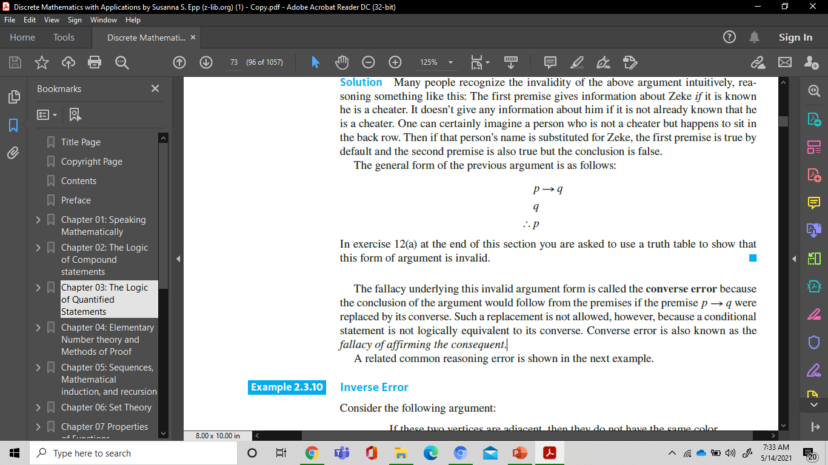
Converse Error
Show that the following argument is invalid:
If Zeke is a cheater, then Zeke sits in the back row.
Zeke sits in the back row.
Zeke is a cheater.
Solution
∴
This invalid argument form is called the converse error because the conclusion of the argument would follow from the premises if the premise p q were replaced by its converse.
A conditional statement is not logically equivalent to its converse.
Converse error is also known as the fallacy of affirming the consequent.
→

Slide 43
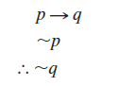
Inverse Error
Consider the following argument:
If these two vertices are adjacent, then they do not have the same color.
These two vertices are not adjacent.
These two vertices have the same color.
∴
This invalid argument form is called the inverse error because the conclusion of the argument would follow from the premises if the premise p q were replaced by its inverse.
A conditional statement is not logically equivalent to its inverse.
Inverse error is also known as the fallacy of denying the antecedent.
→

Slide 44
A Valid Argument with a False
Premise and a False Conclusion
The argument below is valid by modus ponens. But its major premise is false, and so is its conclusion.
If Canada is north of the United States, then temperatures in Canada never rise above freezing.
Canada is north of the United States.
Temperatures in Canada never rise above freezing.
∴

Slide 45
An Invalid Argument with True Premises and a True Conclusion
The argument below is invalid by the converse error, but it has a true conclusion
If New York is a big city, then New York has tall buildings.
New York has tall buildings.
New York is a big city.
∴

Slide 46
Digital Logic Circuits
“Contrariwise,” continued Tweedledee, “if it was so, it might be; and if it were so, it would be; but as it isn’t, it ain’t. That’s logic.” —Lewis Carroll, Through the Looking Glass

Slide 47
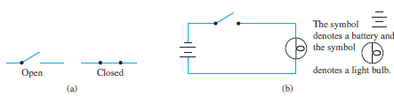
Application:
Digital Logic Circuits
The drawing in Figure :
shows the appearance of the two positions of a simple switch. When the switch is closed, current can flow from one terminal to the other; when it is open, current cannot flow.
The light bulb turns on if, and only if, current flows through it. And this happens if, and only if, the switch is closed.

Slide 48
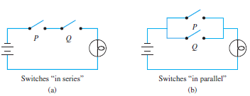
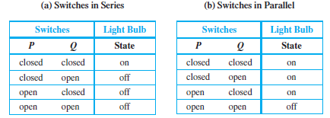
Application:
Digital Logic Circuits
Now consider the more complicated circuits :

Slide 49

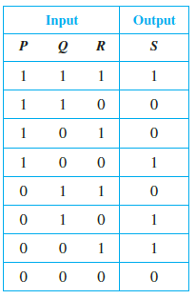
Black Boxes and Gates
The operation of a black box is completely specified by constructing an input/output table that lists all its possible input signals together with their corresponding output signals.

Slide 50
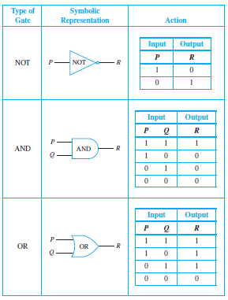
“NOT”, “AND”, and “OR” Gates

Slide 51
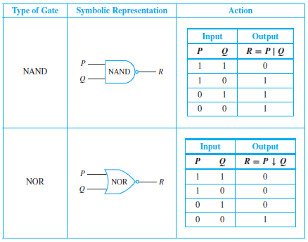
NAND and NOR Gates

Slide 52
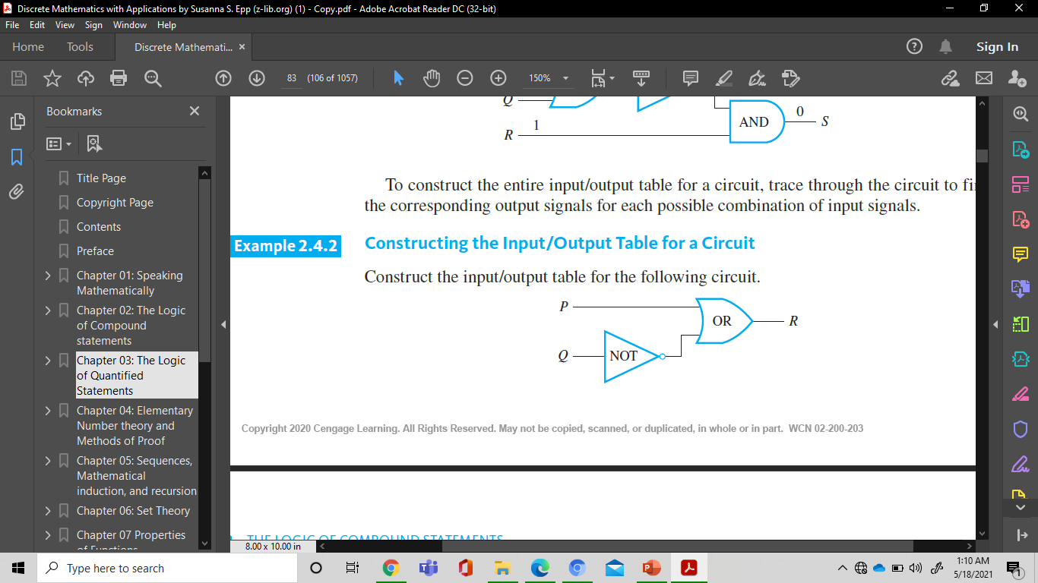
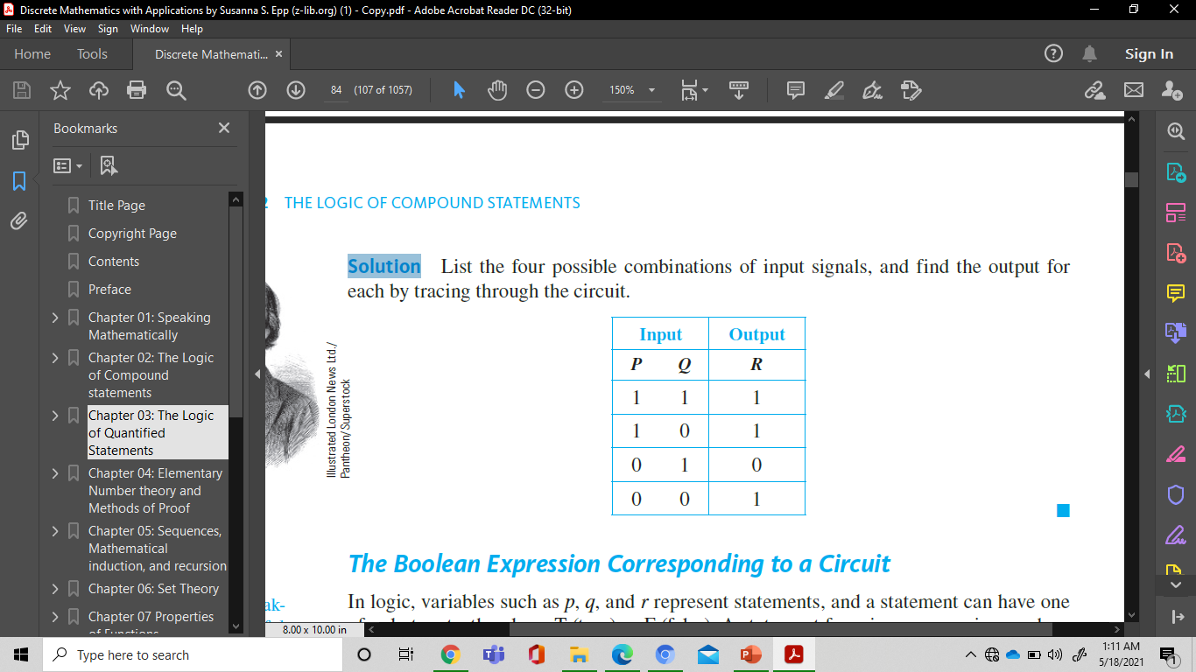
Constructing the Input/Output Table for a Circuit
Construct the input/output table for the following circuit.
Solution :

Slide 53
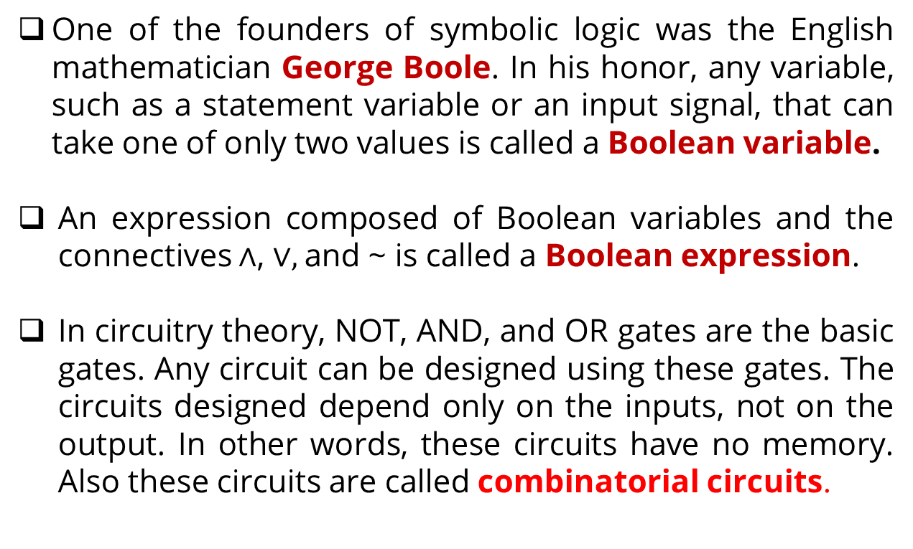
The Boolean Expression Corresponding to a Circuit
One of the founders of symbolic logic was the English mathematician George Boole. In his honor, any variable, such as a statement variable or an input signal, that can take one of only two values is called a Boolean variable.
An expression composed of Boolean variables and the connectives $∧$, $∨,$and ~ is called a Boolean expression.
In circuitry theory, NOT, AND, and OR gates are the basic gates. Any circuit can be designed using these gates. The circuits designed depend only on the inputs, not on the output. In other words, these circuits have no memory. Also these circuits are called combinatorial circuits.

Slide 54
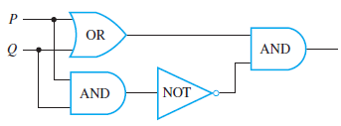
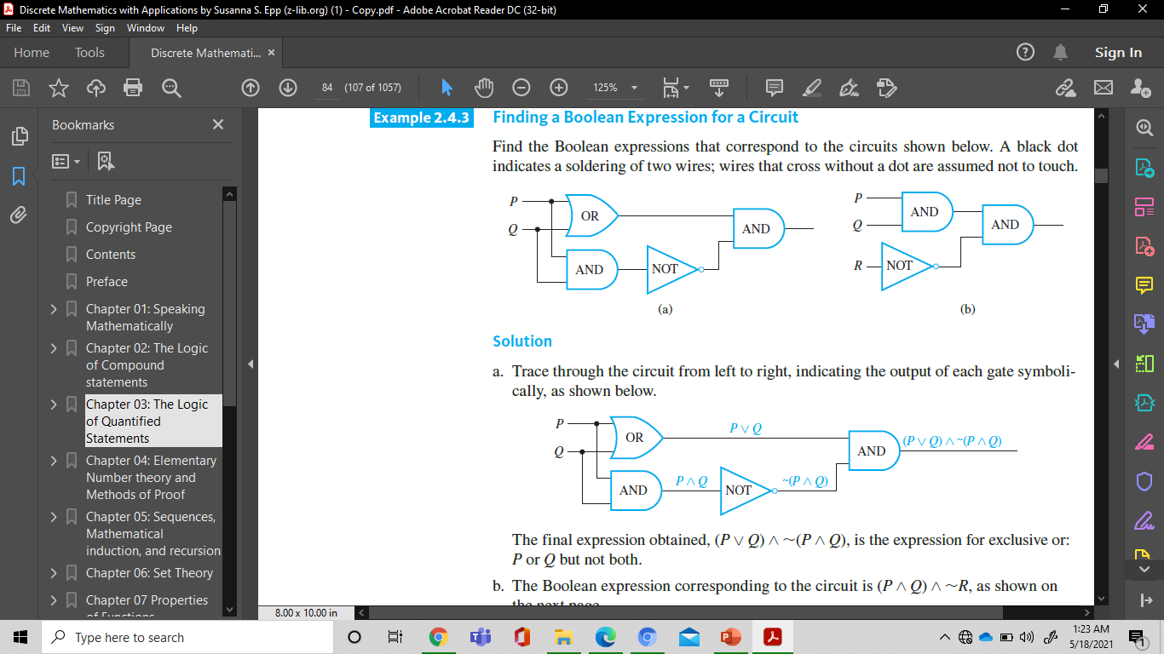
Finding a Boolean Expression for a Circuit
Find the Boolean expressions that correspond to the circuits shown below :
Solution :
The final expression obtained, (P ∨ Q)∧ ∼(P ∧ Q), is the expression for exclusive or: P or Q but not both.

Slide 55
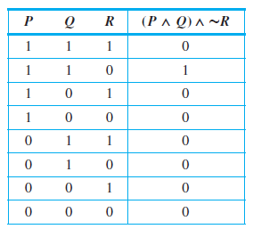
Recognizer
Definition
A recognizer is a circuit that outputs a 1 for exactly one particular combination of input signals and outputs 0’s for all other combinations.

Slide 56

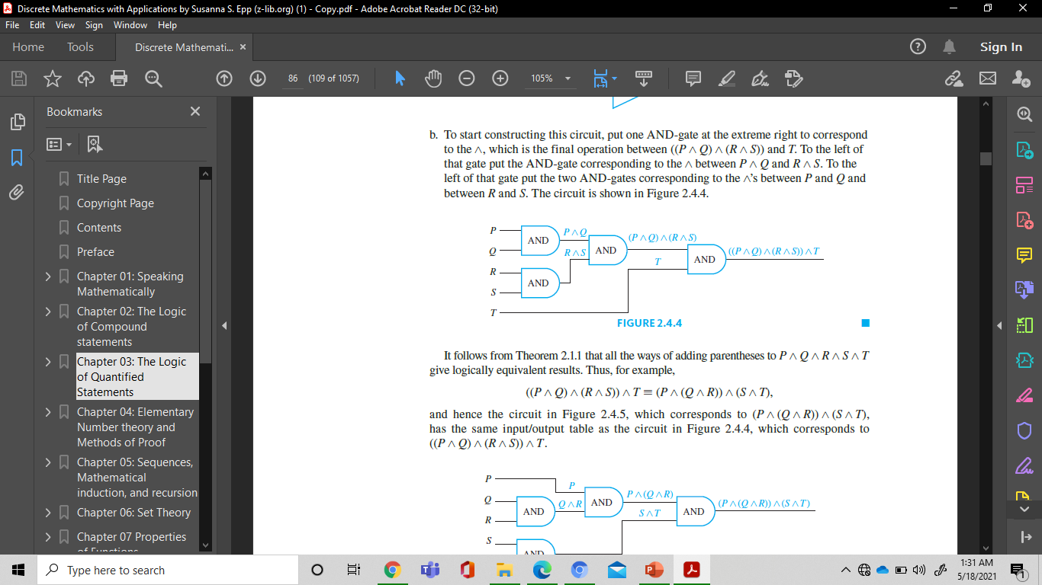
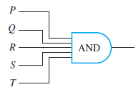
Constructing Circuits for
Boolean Expressions
Construct circuits for the following Boolean expressions
Solution :
a multiple-input AND-gate

Slide 57
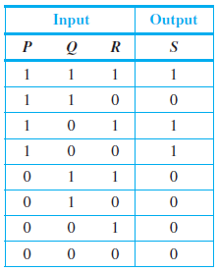
Designing a Circuit for a Given Input/Output Table
Design a circuit for the following input/output table:
Solution :
Identify each row for which the output is 1—in this case, the rows 1, 3, and 4.
(P ∧ Q ∧ R) ∨ (P∧ ∼Q ∧ R) ∨ (P∧ ∼Q∧ ∼R).

Slide 58
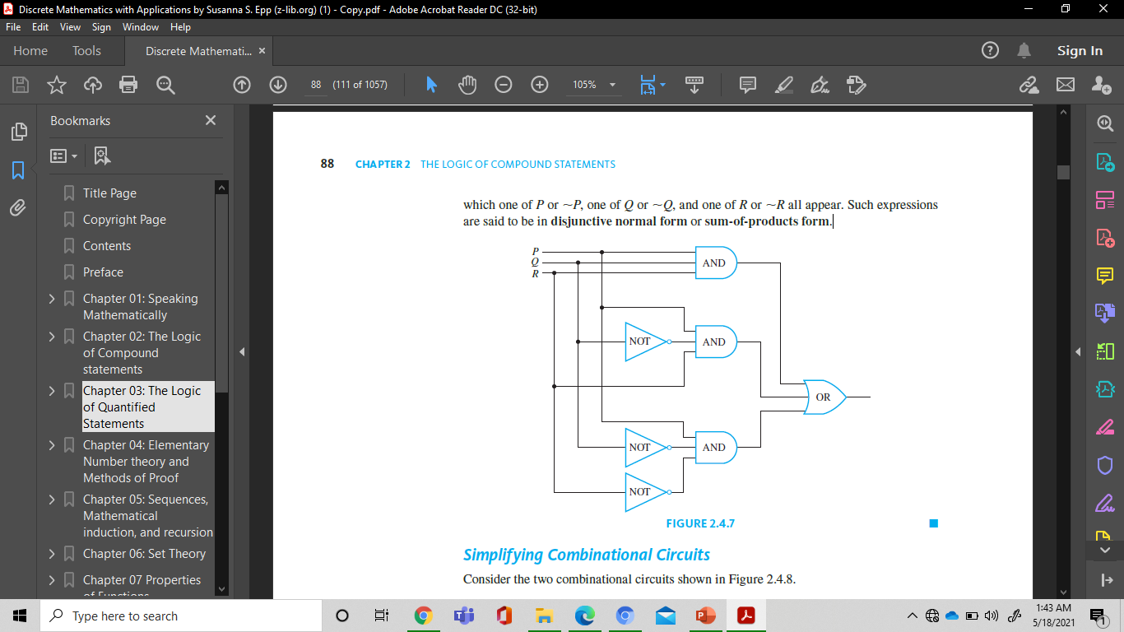
Solution
The circuit corresponding to this expression. Such expressions are said to be in disjunctive normal form or sum-of-products form.

Slide 59
Disjunctive Normal Form (DNF)
Definition
Disjunctive Normal Form (DNF) is a boolean expression E, which has no duplication on the multiplication of each variable
Example:
E1 = X Z’ + X’ Y Z’ + X Y’ Z is DNF
E2 = X Z’ + Y’ Z + X Y Z’ is not DNF, since the multiplication of XYZ’ including XZ’ (XZ’ is the first fundamental product of E2)

Slide 60
Full DNF
Definition
A boolean expression E (X1, X2, ...) is full DNF if each fundamental product of expression consisting of all the variables.
Example:
E = X Y 'Z + X' Y Z + X Y Z ‘
A DNF can be converted into full DNF as follows :
E1 = X Z’ + X’ Y Z’ + X Y’ Z
then full DNF of E1 is
E1 = X Z’(Y+Y’) + X’ Y Z’ + X Y’ Z
= X Z’Y + XZ’Y’ + X’ Y Z’ + X Y’ Z

Slide 61
Consensus
Definition
Let P1 and P2 are fundamental product. If exactly one variable which has complement on P1 and P2, then consensus (Q) from P1 and P2 is multiplication of each variables in P1 and P2 without complement variable and written : P1 + P2 = P1+ P2 + Q
Example :
Let P1 = xy’zp and P2 = xyt, then consensus of P1 and P2 is Q = xzpt , and written :
xy’zp + xyt = xy’zp + xyt + xzpt
2. Let P1 = xy’z and P2 = x’yzp, then P1 and P2 don’t have consensus because P1 and P2 have two complement variable, they are x and y.

Slide 62
Theorem of Fundamental
Product
Theorem (Include)
If fundamental product P2 including fundamental product P1, then
P1+P2=P1
Example :

Slide 63
Karnaugh Map

Slide 64
Karnaugh Map
A Karnaugh map or K-map, for finding terms to combine for Boolean functions involving a relatively small number of variables
The method we will describe was introduced by Maurice Karnaugh in 1953. His method is based on earlier work by E.W. Veitch.
K-maps give us a visual method for simplifying sum-of-products expansions; they are not suited for mechanizing this process
A Karnaugh map has zero and one entries at different positions. Each position in a grid corresponds to a truth table entry.
Given a Boolean function described by a truth table or logic function, then:
Draw the Karnaugh Map for the function.
Use the information from a Karnaugh Map to determine the smallest sum-of-products function.

Slide 65
Karnaugh Map in
Two Variables
There are four possible minterms in the sum-of-products expansion of a Boolean function in the two variables x and y.
A K-map for a Boolean function in these two variables consists of four cells, where a 1 is placed in the cell representing a minterm if this minterm is present in the expansion. Cells are said to be adjacent if the minterms that they represent differ in exactly one literal.
For instance, the cell representing is adjacent to the cells representing
and

Slide 66
Karnaugh Map in
Two Variables
Example :
Find the K-maps for Boolean expression E that equal to :
Solution :
E = y
E =
E =

Slide 67
Karnaugh Map in Three
Variables
Let α(x,y,z) be a sum of product Boolean expression such that minterm consists of three variables x,y,z. To define the K-map for α(x,y,z) , we consider the following table

Slide 68
Blocks in K-maps in Three
Variables.

Slide 69
Karnaugh Map in Three
Variables
Example :
Use K-maps to minimize these sum-of-products expansions

Slide 70
Karnaugh Map in Three
Variables
Solution :

Slide 71
A K-map in Four Variables
Let α(x,y,z,w) be a sum
of product Boolean
expression such that
minterm consists of
three variables x,y,z,w.
To define the K-map
for α(x,y,z,w), we
consider the following
table

Slide 72
A K-map in Four Variables

Slide 73
A K-map in Four Variables
Example :
Use K-maps to simplify these sum-of-products expansions.

Slide 74
A K-map in Four Variables
Solution :

Slide 75
References
Susanna S.Epp, “ Discrete Mathematics with Applications”, 5th edition,2020, Cengage, Boston, USA, ISBN 9781337694193
Kenneth H. Rosen, “ Discrete Mathematics and its Applications”, 8th edition,2019, McGraw-Hill Education, New York, ISBN 978-1-259-67651-2

Slide 76
THANK YOU

